Slide 1
Chapter 2.6
Estimating to Achieve Target Project Costs

Slide 2
Completed estimate requires:
Permanent costs of the physical structure and the soft costs born by the trades to complete that work
  The subcontracted work
General condition costs, overhead, profit

Slide 3
General conditions (GCs) are work required to complete project but are not included in finished work
GC work items usually not shown on any plans, and only some shown in specs
Experience determines what is required
Requirements sometimes differ from one project type to another

Slide 4
Temporary work is required to build permanent work.
Bidder’s approach
  Subs for elevated concrete work may have aluminum shoring versus wood shoring
  Siding contractor may use man lift versus pump jacks
Analysis and communication between subs and GC for temporary structures that all trades can use such as scaffolding

Slide 5
GCs are more affected by time
than permanent work
Supervision and equipment incur daily costs regardless of what is accomplished
  Rain or shine, weekends, holidays, etc.
Additional expenditures on larger cranes, hoists, and haul roads can vastly increase productivity and speed of construction
  Optimization of resources is key. Having a daily hoist schedule for the cranes is essential

Slide 6
Estimating General Conditions

Slide 7
Permanent building and GC estimating methods are the same:
Template is reviewed and adjusted as necessary for each project
Labor, material, and sub vendor work measured and costed
Adjustments for productivity, risk and waste
Costing all general conditions work as a % of construction should be avoided
  “Supervision cost will be 0.025% of total cost…” not acceptable for final value, but may be useful for initial target costs

Slide 8
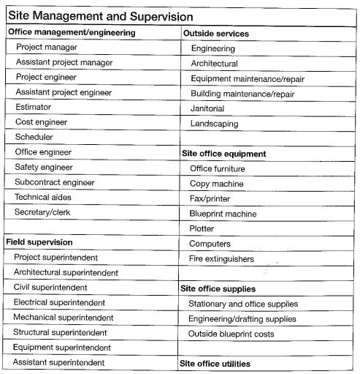

Slide 9
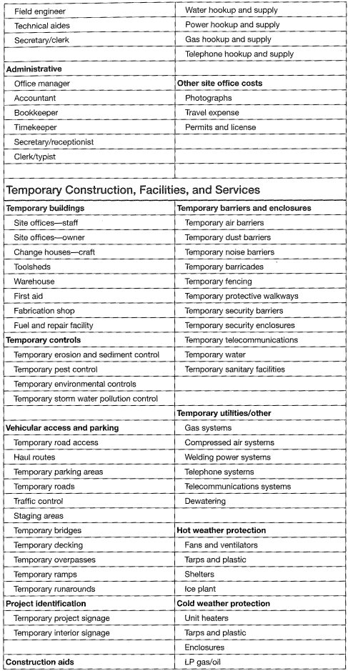

Slide 10
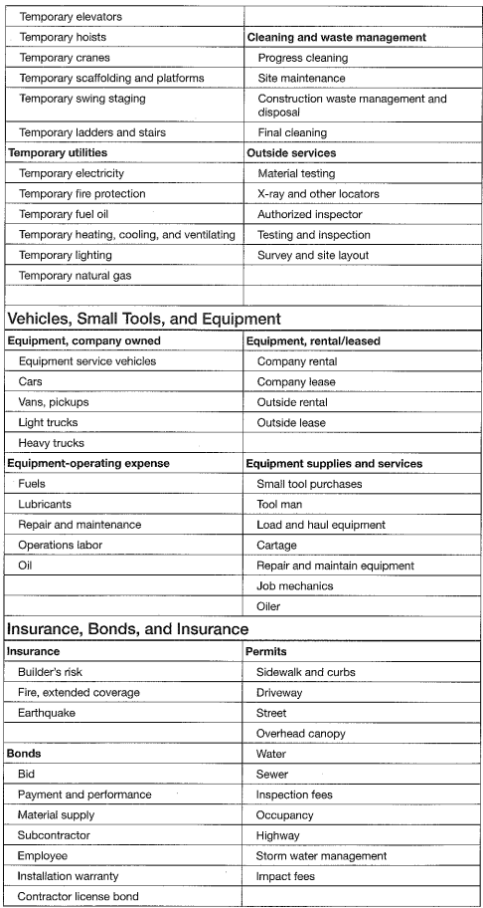

Slide 11
Supervision and equipment costed by duration
Supervision, management and equipment are costed by unit costs times duration
Equipment maintenance and servicing must be added – how do you maintain productivity during down-time?
Equipment set up and removal costs must be added
  Mobilizations are significant, so plan work accordingly to optimize equipment
  Optimize usability by analyzing cycle times

Slide 12
Insurance and bonds can be general or project specific
General:
Payroll, liability and equipment insurance mostly annual and company wide.(These costs are included in labor burdens and overhead)
Project specific:
Builders risk
Bid, payment and performance bonds
Other bonds or insurance required by specifications

Slide 13
Permits
Permits and fees vary from under 1% to over 10% of construction cost
Accurate permit rate structures sometimes not available
Further impact and tap fees may also be added
Sometimes it is permissible to manage permit fees as an allowance or even exclude the costs.

Slide 14
Estimating and Managing Overhead and Profit

Slide 15
Home Office Overhead and Profit Must Be Costed
Home office overhead can include:
Some tools and equipment
Home office vehicle expenses
Insurance not included in direct cost of work
Office employees: project engineers, estimators, accounting, clerical support and shop labor, etc.
Office rental, utility expenses, office services and supplies

Slide 16
For CM, overhead and profit must be presented carefully
Profit is what remains after all costs are paid
  Profit is also the payment the market will bear for CM’s efforts and risk
Project owners may see office overhead (a real cost) and profit as the same, but they are not.

Slide 17
Minimize office overhead into a single line item for most owners.
  Less information the better, less opportunity for the owner to question and argue necessary costs
Relocating office overhead costs to direct cost of work may be needed.
  Staff that works specifically on one job and has costs that can be forecasted and monitored.

Slide 18
The approach to the scope affects both time and cost
Building blocks determines range of possible construction times
Time determines much of cost of general conditions
So approach and time must be adjusted and revised until targeted cost and time together are reached
  Overlap of trade work is essential

Slide 19
Selection of vendors with needed speed may be required, which will by extension increase the cost of that scope of work, but will likely reduce general conditions costs. It’s a balance of return

Slide 20
Irrational Actions,
Assumptions and Risk
Modify Costs

Slide 21
Stated specification may be imperfect
Owners seldom know exactly what they really want
  In the standard model of design-bid-build, the Architect tries to align this as accurate as possible, but is limited to how well the owner communicated their needs
Specifications may not be accurate

Slide 22
Expectations influence reality
Each type of project will have expected productivity, risk and cost
Scope, time and cost may be altered to meet expectations

Slide 23
Risk modifies cost
Government interference (regulations and slow permits)
Neighborhood or political objections can cause delays
Abnormally bad weather
Labor, material and equipment shortages
Late or nonpayment by owner

Slide 24
Costs and prices are usually closely related, but can temporarily disconnect in times of:
Boom — Demand for material, skilled labor, and vendors exceeds available supply
Bust—firms will take drastic measures and big risks to keep busy

Slide 25
Project owner actions can affect productivity
Failure to provide correct information when needed
  Architect not responding in a timely manner to RFIs and Submittals, etc.
Frequent changes in work
Owner scheduled vendors interfering with work

Slide 26
Finalizing Cost Estimate so Change Orders are Limited

Slide 27
Final estimated cost (for CM) should change little during construction
Large or numerous cost increase change orders suggest poor management
Change management then focuses on resistance to unwanted change
Claim management is also key
Design-bid-build delivery, in contrast, can have many large change orders

